Slide 1
CS4059-Fundamentals of Computer Vision Project Report, Spring 2023 Face Mask Detector
Group Member:
Tayyib Ismail 20k-0461
Course Instructor:
Sir Farrukh Shahid

Slide 2
Introduction
The COVID-19 pandemic has affected the world in many ways, and one of the most significant changes has been the widespread use of face masks.
Wearing a mask in public had been a common practice to prevent the spread of the virus, and had been an essential component of our daily lives. With the help of deep learning and computer vision, it is possible to automatically detect whether an individual is wearing a mask or not, which could have been useful in various settings such as public transportation, hospitals, and schools.
In this presentation, we will explore how we can use machine learning to train a model to detect face masks in images using a dataset of people wearing and not wearing masks.

Slide 3
Data Set:
The dataset used in this project is the Face Mask Detection dataset, which contains a total of 7,553 images of people with and without masks.
The images are divided into two categories: "with mask" and "without mask". The dataset was sourced from Kaggle and was created by Omkar Gurav. It was designed to aid in the development of models for automatic face mask detection.
The images were collected from a variety of sources and feature people of various ages, genders, and races. In this project, we used the dataset to train a deep learning model to identify whether a person is wearing a mask or not.

Slide 4
Methodology
To develop a face mask detector, we used the Convolutional Neural Network (CNN) algorithm. CNNs are a type of neural network that are particularly well-suited for image classification tasks.
They consist of multiple layers of convolutional filters and pooling layers, which are used to extract features from the input images. These features are then passed through a series of fully connected layers to produce the final classification output.
Our CNN architecture consists of two convolutional layers, each followed by a max-pooling layer to reduce the spatial dimensions of the output.
The output of the second pooling layer is then flattened and passed through two fully connected layers, each with a dropout layer to prevent overfitting.
Finally, the output is passed through a dense layer with a sigmoid activation function to produce the binary classification output.

Slide 5
Implementation
To implement the face mask detector, we used the Keras library in Python. We first downloaded the face mask dataset from Kaggle, which contains two classes of images: with mask and without mask. We then preprocessed the images by resizing them to 128x128 pixels and converting them to RGB format.
Next, we split the dataset into training and testing sets, with a 20% split for testing. We also scaled the pixel values to be between 0 and 1 to improve model performance.
We then constructed the CNN architecture described in slide 3 using Keras, and compiled the model using the Adam optimizer and sparse categorical cross-entropy loss function. We trained the model for 10 epochs, monitoring the validation loss and accuracy to prevent overfitting.
Finally, we evaluated the model on the testing set and achieved an accuracy of 96%. We also tested the model on a sample image, and the model correctly classified whether the person in the image was wearing a mask or not.

Slide 6
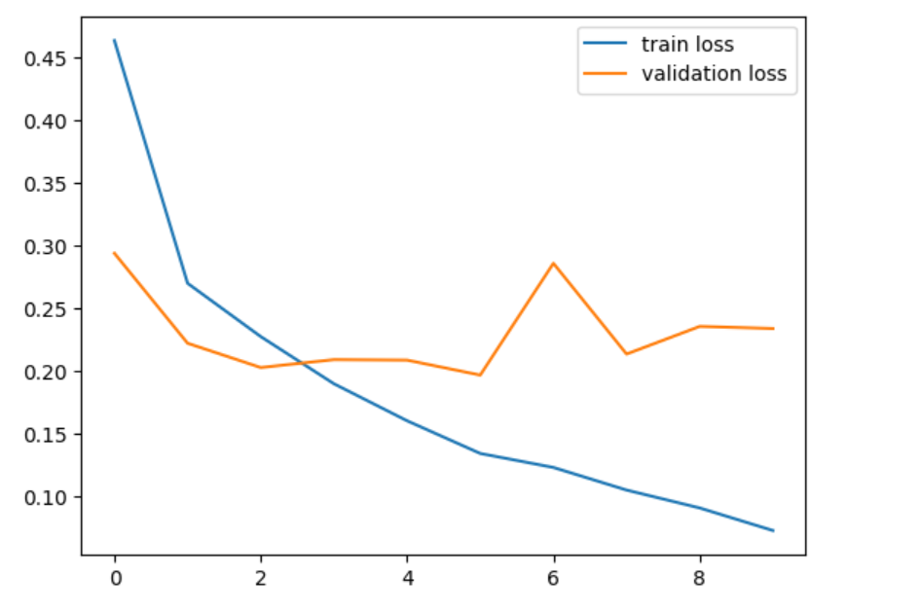
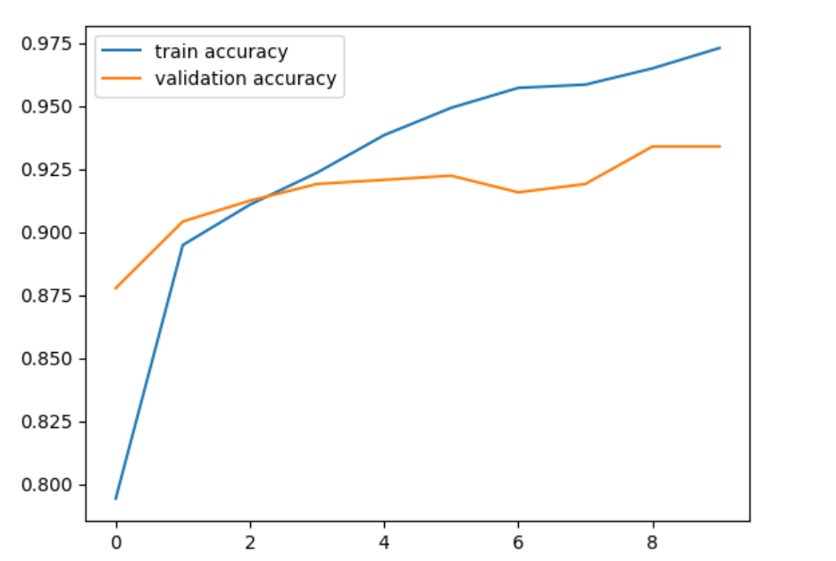
Graphs

Slide 7
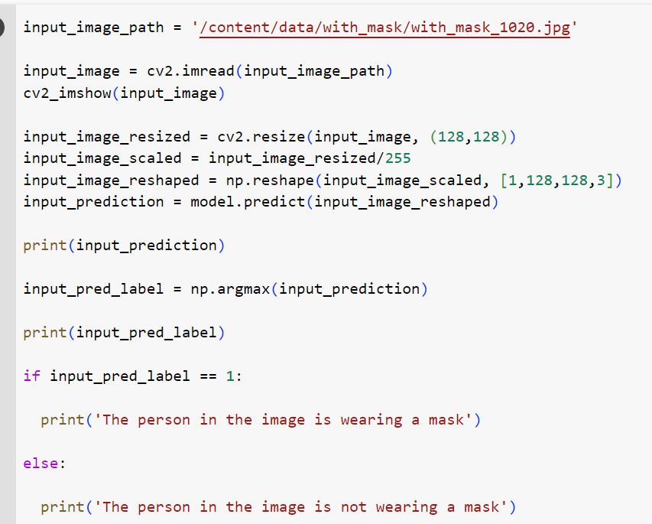
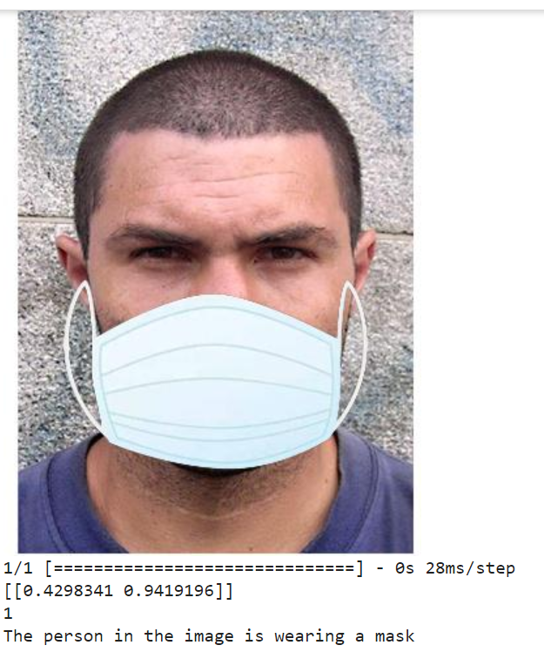
Demonstration

